Slide 1
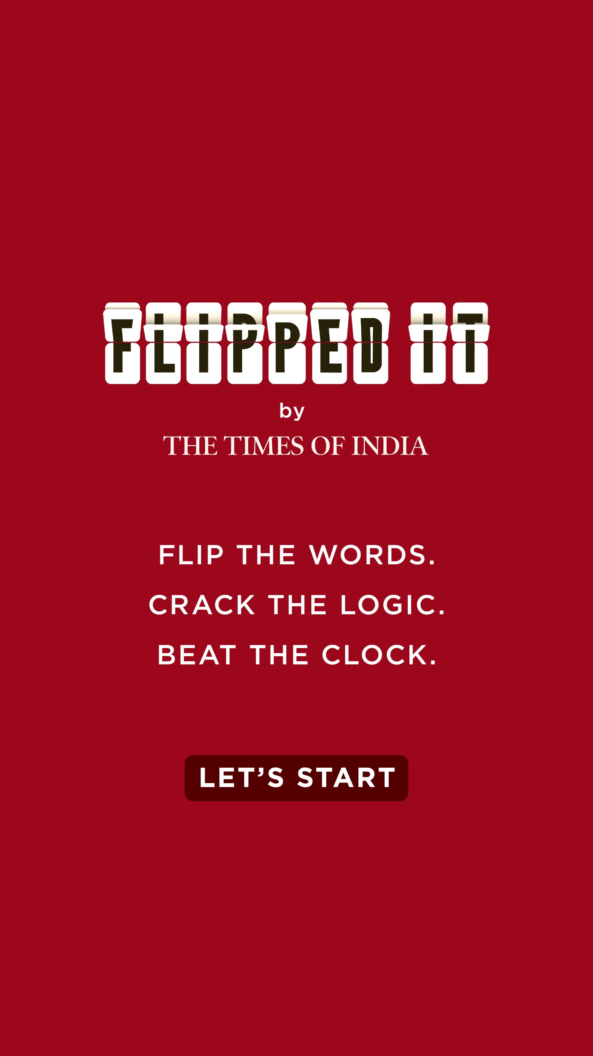
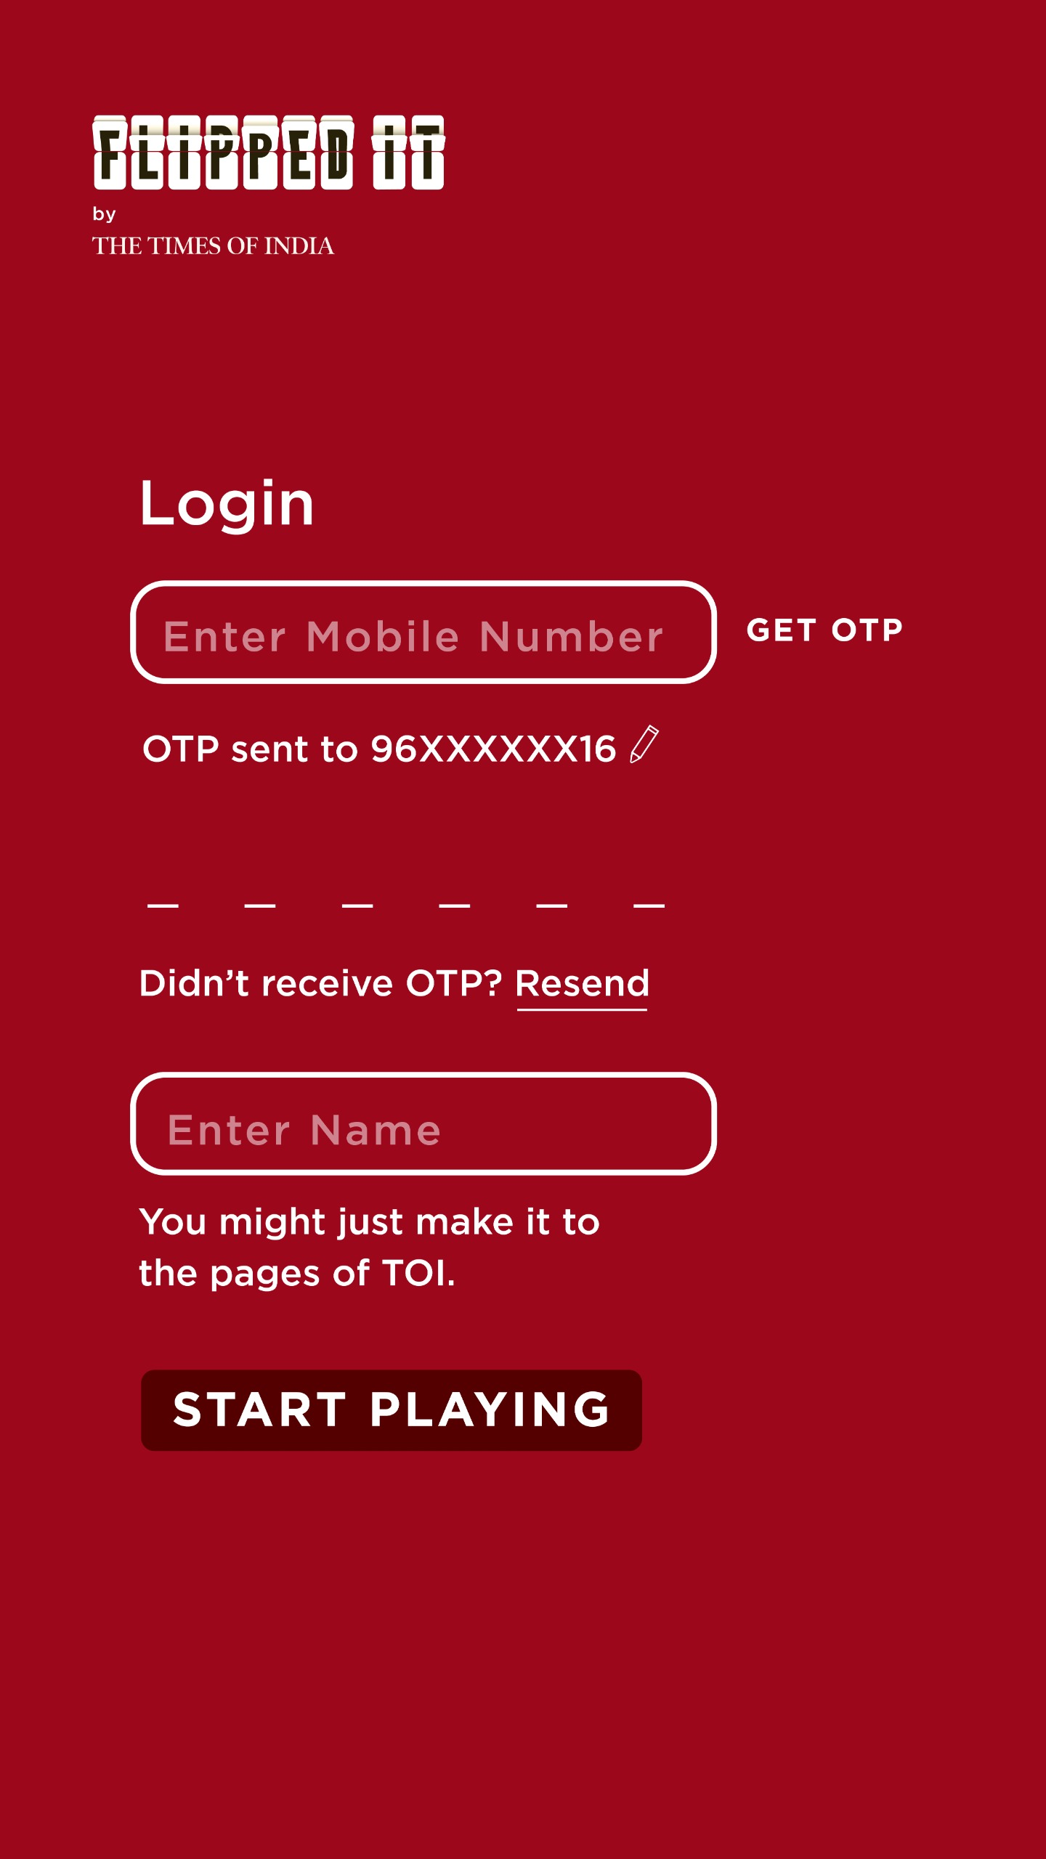
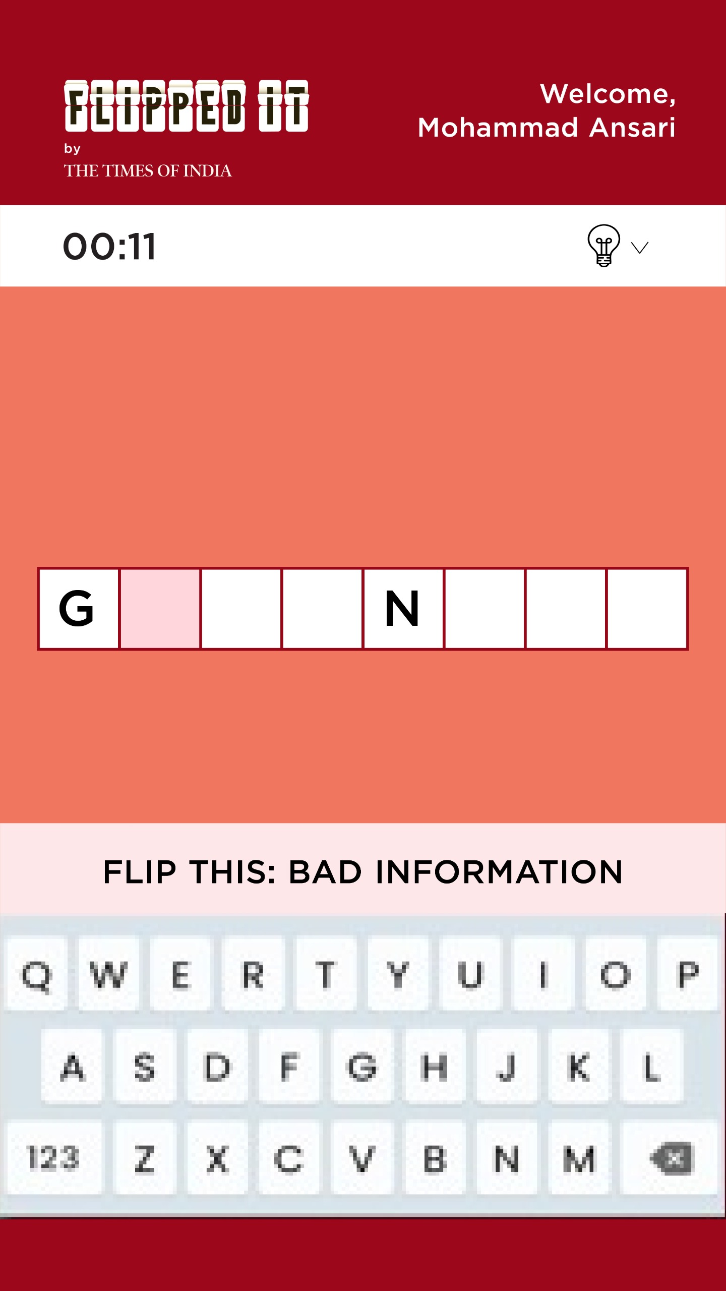
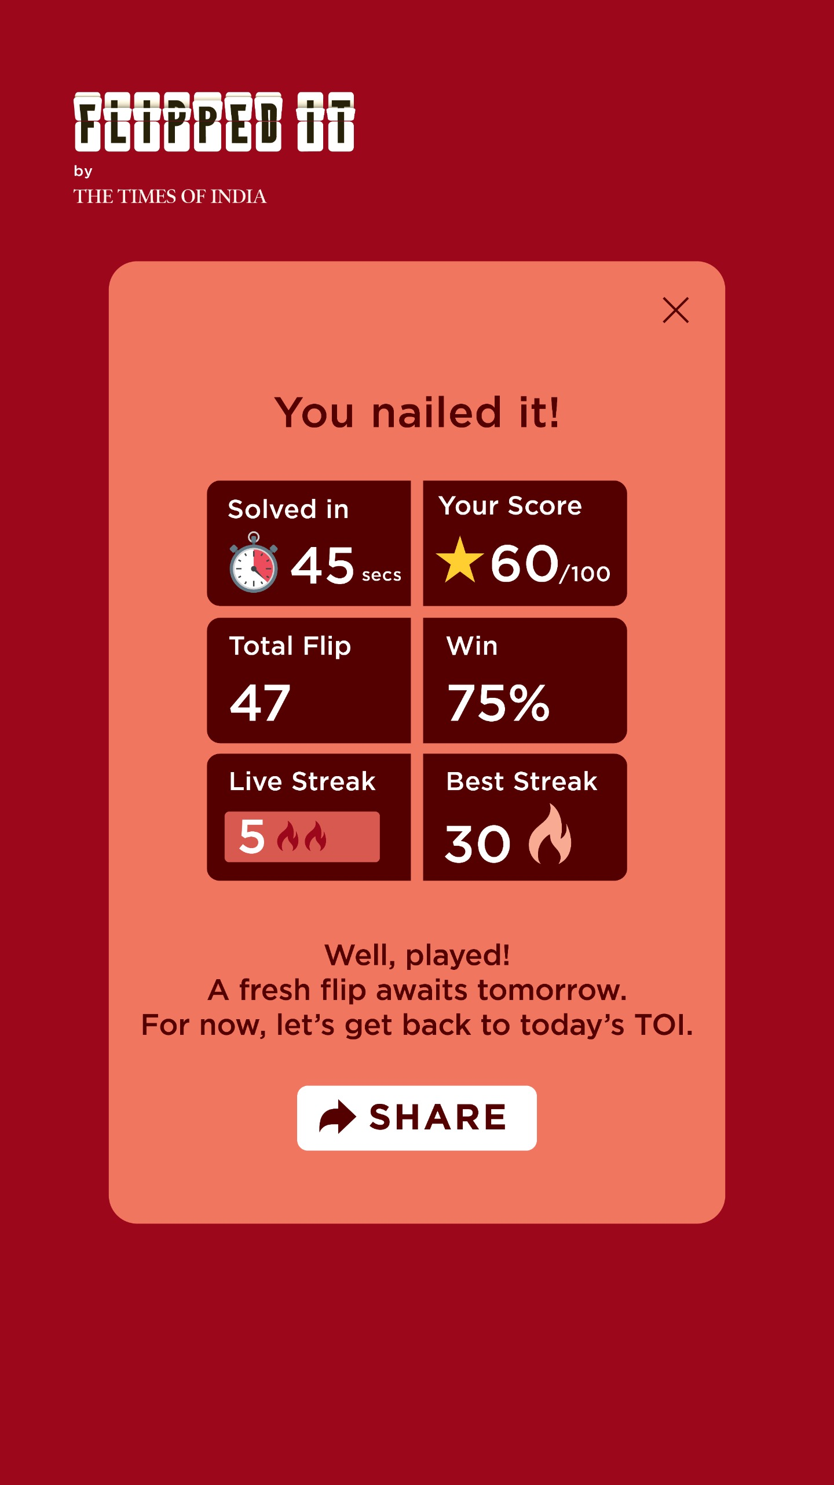



Web App | UI
Game Screen
Login
Game Interface
Score card

Slide 2
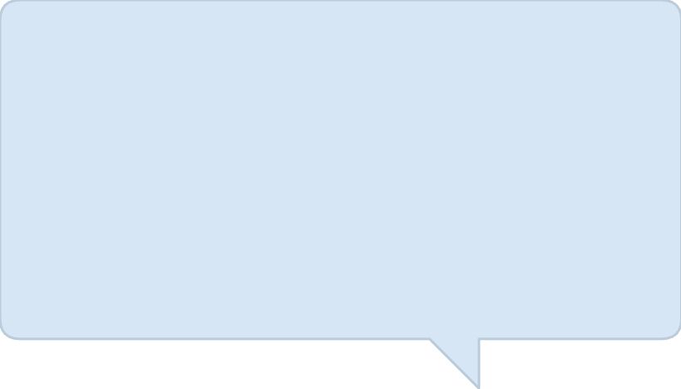
Customised Response | Success
Upon completing a puzzle, players receive a rotating congratulatory message that reinforces the daily habit, celebrates the win, and bridges back to the TOI reading experience
Text on Rotation
"Great flip! Another one lands tomorrow. Until then, enjoy the rest of today's TOI."
"Well, played! A fresh flip awaits tomorrow. For now, let's get back to today's TOI."
"Nice work! Tomorrow brings a new challenge. Until then, read through today's TOI."
"Smooth finish! Another puzzle drops tomorrow. Meanwhile, dive back into today's TOI."
"You aced it! Come back for tomorrow's flip. Until then, carry on with today's reading."
"Flip mastered! A new one arrives tomorrow. For now, enjoy the rest of today's newspaper."

Slide 3
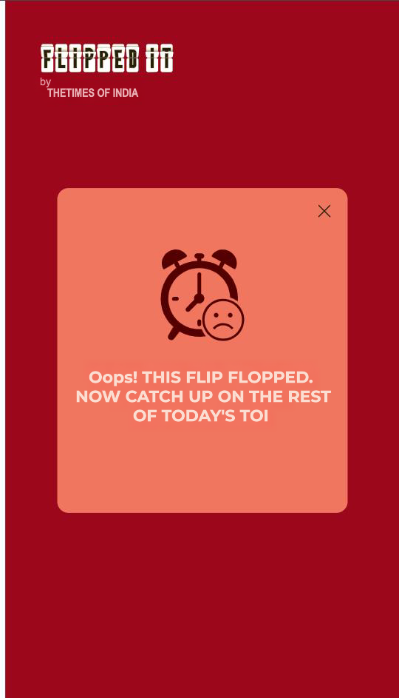
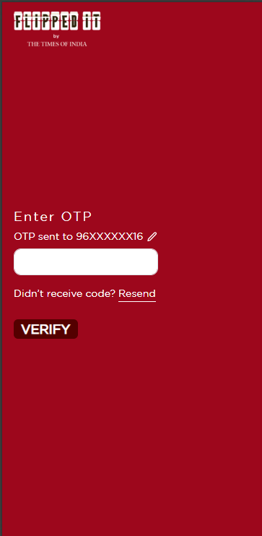
Web App | Time Out Screen- UI

Slide 4

Customised Response | Unsuccessful
Text on Rotation
"Oops! This flip flopped. Try again tomorrow. Now go catch up on the rest of today's TOI."
"This flip slipped away… but the rest of today's TOI is waiting for you."
"The puzzle dodged you today — turn the page and keep reading the TOI."
"Your brain fought bravely; the puzzle fought harder. Time to dive back into today's TOI."
"This one slipped away… but tomorrow is another flip. Go on, continue reading your newspaper."

